Slide 1


Module 3 Recommendations for Restaurants Serving Fast Food
Group 2
Fengxia Dong, Zhiyu Ji, Xinyue Wang

Slide 2
Contents
Introduction and Motivation
Data Cleaning and Pre-Processing
Exploratory Data Analysis
Key Findings About Restaurants Serving Fast Foods
Recommendations for Restaurants Serving Fast Foods
Shiny App Demonstration

Slide 3
Introduction and Motivation
Our analysis focuses on restaurants that provide fast food to customers.
Their average stars were only 2.69 on Yelp during the period of 10/2004 to 12/2019.
This category of restaurants has not been serving customers well.
They need advice to improve.

Slide 4
Data Cleaning and Pre-Processing
Select businesses in business json file with “fast food” listed in its category.
Select reviews for the chosen businesses from review json file.
Select related users and tips from user json file and tip json file, respectively.
33,262 reviews by 21,741 users for 1,638 restaurants serving fast food with 5,823 tips.

Slide 5
Data Cleaning and Pre-Processing
Utilize the R package “tidy2vec” to break the text into individual tokens and transform the list of tokens into a vector space.
Prune words occurring less than 10 times and those appearing in less than 0.1% of reviews.
Create a document-term matrix (DTM) for our further analysis.
In total, we have 15,163 words in the DTM.

Slide 6
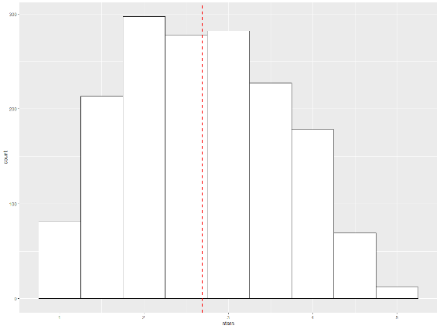
Exploratory Data Analysis
Selected restaurants are located in the states of Illinois, Ohio, Wisconsin, and Pennsylvania, with average stars ranging from 2.64 to 2.82.
Mean of stars is 2.69 with standard deviation of 0.94.

Slide 7
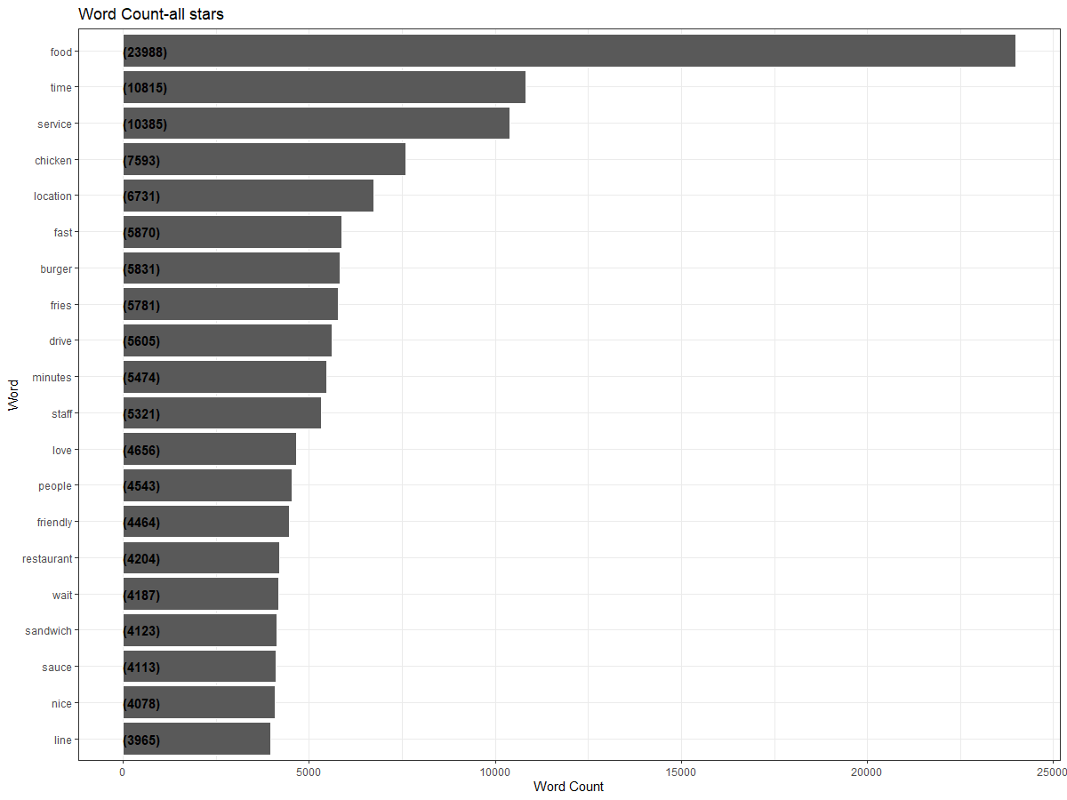
Exploratory Data Analysis
Examine the frequency of words appearing in reviews by using “tidytext” package in R.
Words that are not useful for an analysis are excluded.

Slide 8
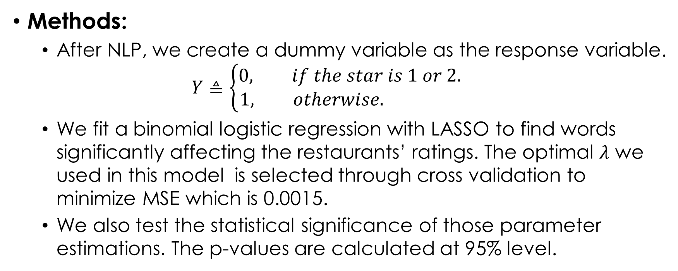
Key Findings
Methods:
After NLP, we create a dummy variable as the response variable.
$$Y≜\left\{\begin{aligned}0, if the star is 1 or 2. \\ 1, otherwise. \end{aligned}\right.$$
We fit a binomial logistic regression with LASSO to find words significantly affecting the restaurants’ ratings. The optimal $λ$ we used in this model is selected through cross validation to minimize MSE which is 0.0015.
We also test the statistical significance of those parameter estimations. The p-values are calculated at 95% level.

Slide 9
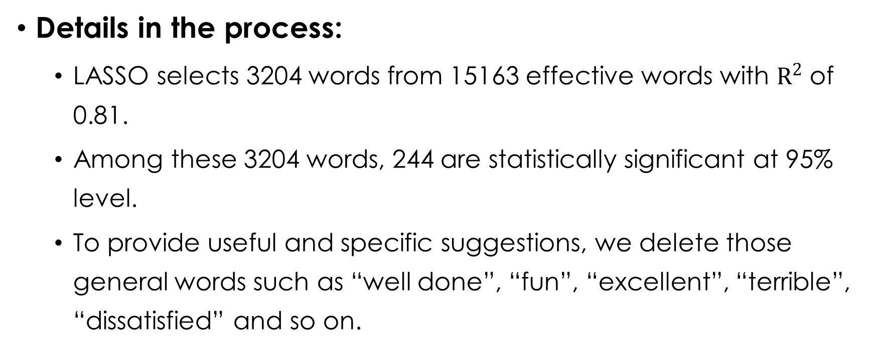
Key Findings
Details in the process:
LASSO selects 3204 words from 15163 effective words with $R^{2}$ of 0.81.
Among these 3204 words, 244 are statistically significant at 95% level.
To provide useful and specific suggestions, we delete those general words such as “well done”, “fun”, “excellent”, “terrible”, “dissatisfied” and so on.

Slide 10
Key Findings
 | word | parameter estimates | p-value |  | word | parameter estimates |  |  | p- value
Service | Poor_service | -1.07 | 0.01 | waiting- | 40_minutes | -0.64 |  |  | 0.04
 | decent_price | 0.62 | 0.02 | time | Quick | 2.10 |  |  | 0.04
 | apologies | -1.79 | 0.05 |  | for_15 | -0.38 |  |  | 0.00
 | horrible_service | -0.73 | 0.04 |  | for_20 | -0.79 |  |  | 0.01
 | friendliness | 2.10 | 0.05 |  | slow_and | -0.73 |  |  | 0.00
 | attitude | -0.23 | 0.02 |  | Fast | 0.68 |  |  | 0.04
 | rude | -1.35 | 0.02 |  | minutes_to | -0.23 |  |  | 0.02
 | the_service | 0.09 | 0.02 |  | in_line | -0.31 |  |  | 0.00
 | incompetent | -1.05 | 0.02 |  | over_15 | -0.91 |  |  | 0.01
 | Delivery | 0.63 | 0.05 |  | waited | -0.19 |  |  | 0.00
 | greet | 0.34 | 0.03
 | their_job | -0.33 | 0.04
food | is_cold | -1.64 | 0.02 | Sanitary | clean_and |  | 0.21 | 0.05
 | not_fresh | -1.81 | 0.02 | condition | dirty_tables |  | 1.29 | 0.05
 | Huge | 0.61 | 0.02
 | kids_meal | 1.02 | 0.03
 | ingredients_and | 0.74 | 0.03
 | were_delicious | 0.37 | 0.05
 | Great_food | 0.80 | 0.05
Results:
The most important words in those selected significant words are grouped in targeted areas as listed in the right table.

Slide 11
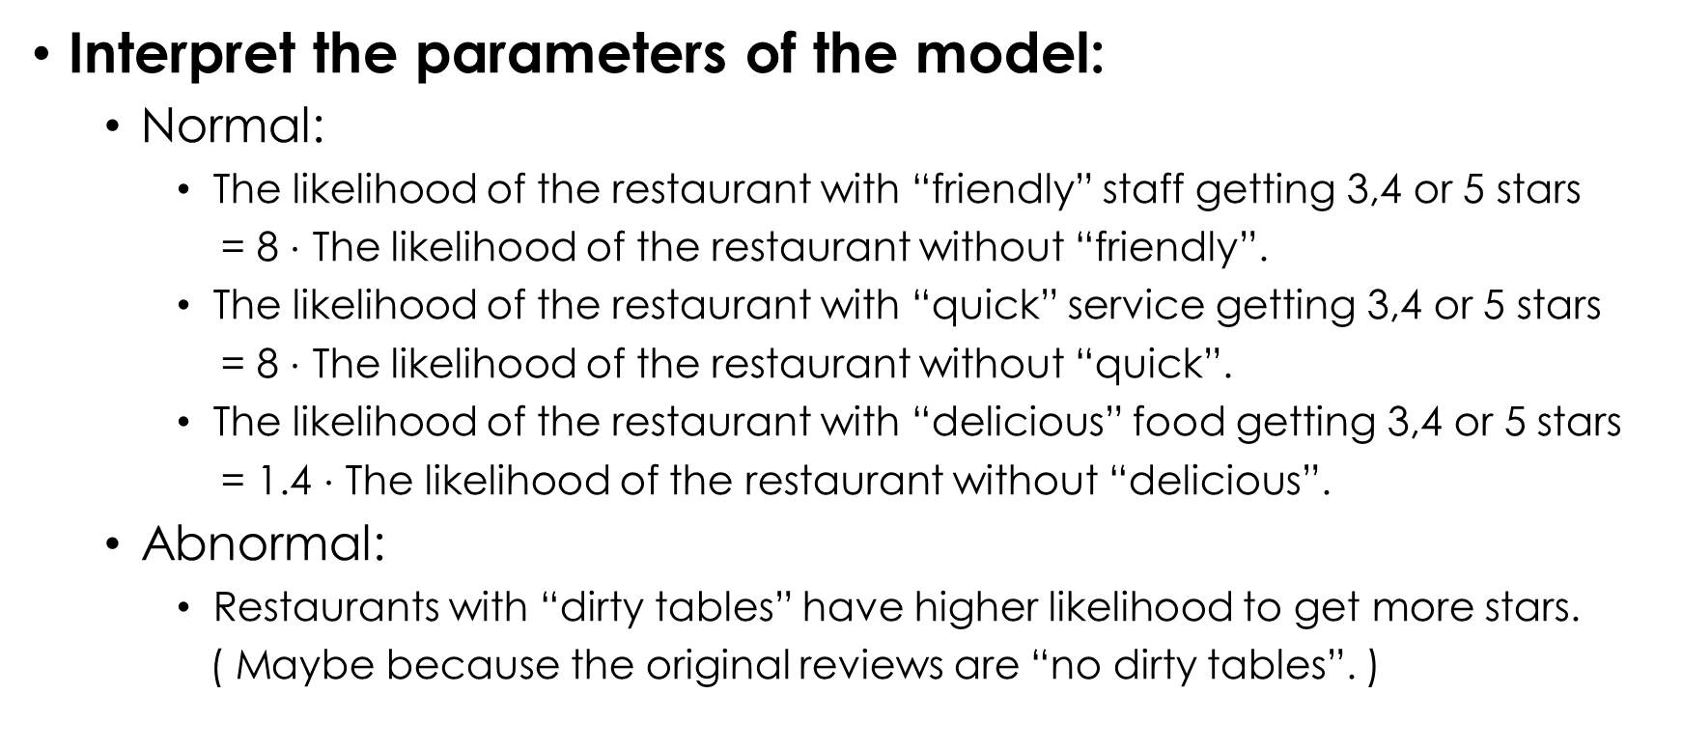
Recommendations
Interpret the parameters of the model:
Normal:
The likelihood of the restaurant with “friendly” staff getting 3,4 or 5 stars
= 8 $⋅$ The likelihood of the restaurant without “friendly”.
The likelihood of the restaurant with “quick” service getting 3,4 or 5 stars
= 8 $⋅$ The likelihood of the restaurant without “quick”.
The likelihood of the restaurant with “delicious” food getting 3,4 or 5 stars
= 1.4 $⋅$ The likelihood of the restaurant without “delicious”.
Abnormal:
Restaurants with “dirty tables” have higher likelihood to get more stars.
( Maybe because the original reviews are “no dirty tables”. )

Slide 12
Recommendations
Suggestions:
Train staff to provide good services, be friendly and reduce mistakes as much as possible.
Keep price at a reasonable level.
Use fresh ingredients in food and be kids friendly by offering “kids meal”.
While providing delicious food is important, consider increasing the portion of some food.
Reduce waiting time by preparing well before rush hours and training employees to be more efficient.
Clean the restaurants as thoroughly as possible.

Slide 13
Recommendations
Future directions of improvement:
Consider higher value of “ngram” to avoid weird results such as “dirty tables” mentioned previously.
To make full use of known information, we can also fit a linear regression later to provide a numeric estimate of an increase in stars if adopting any of the suggestions.

Slide 14
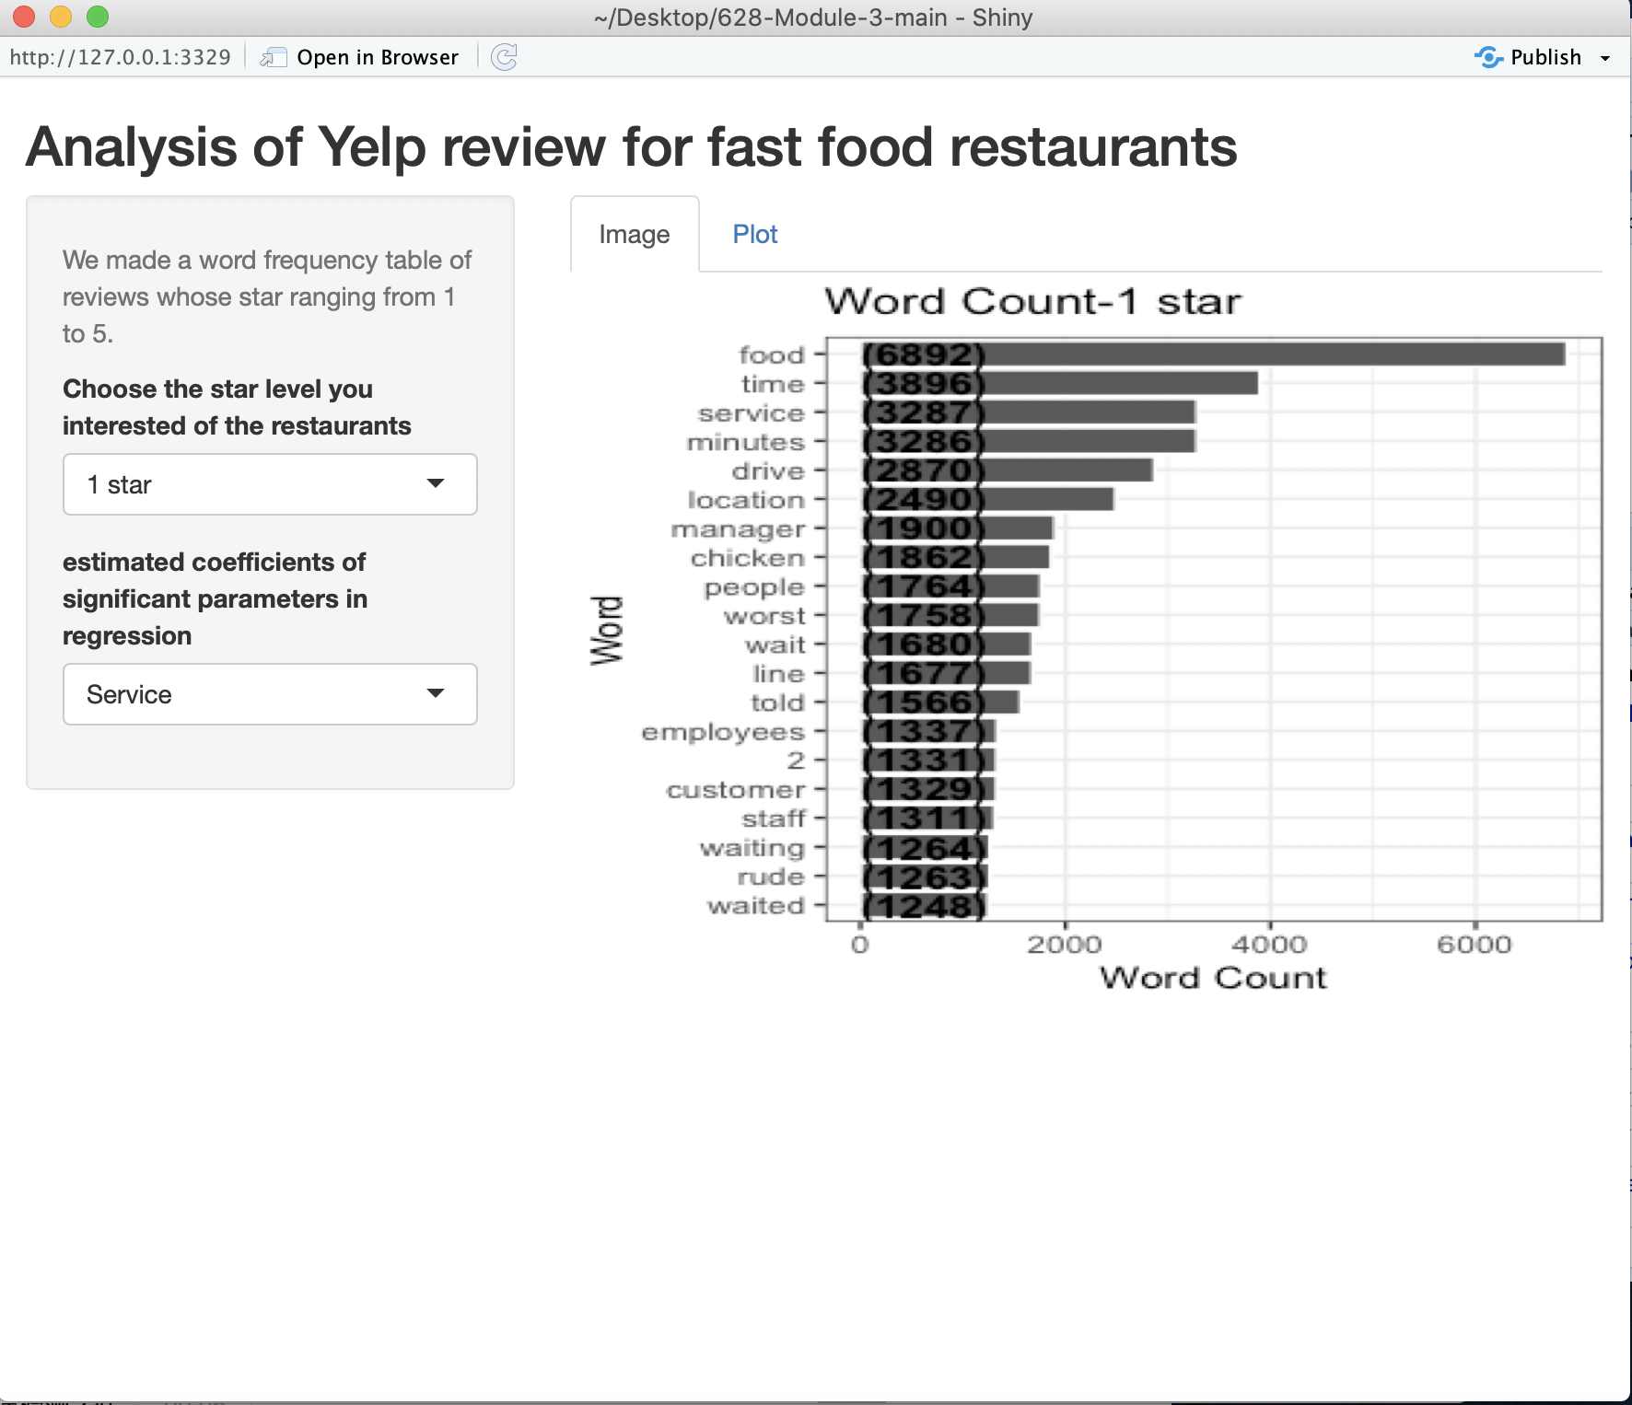
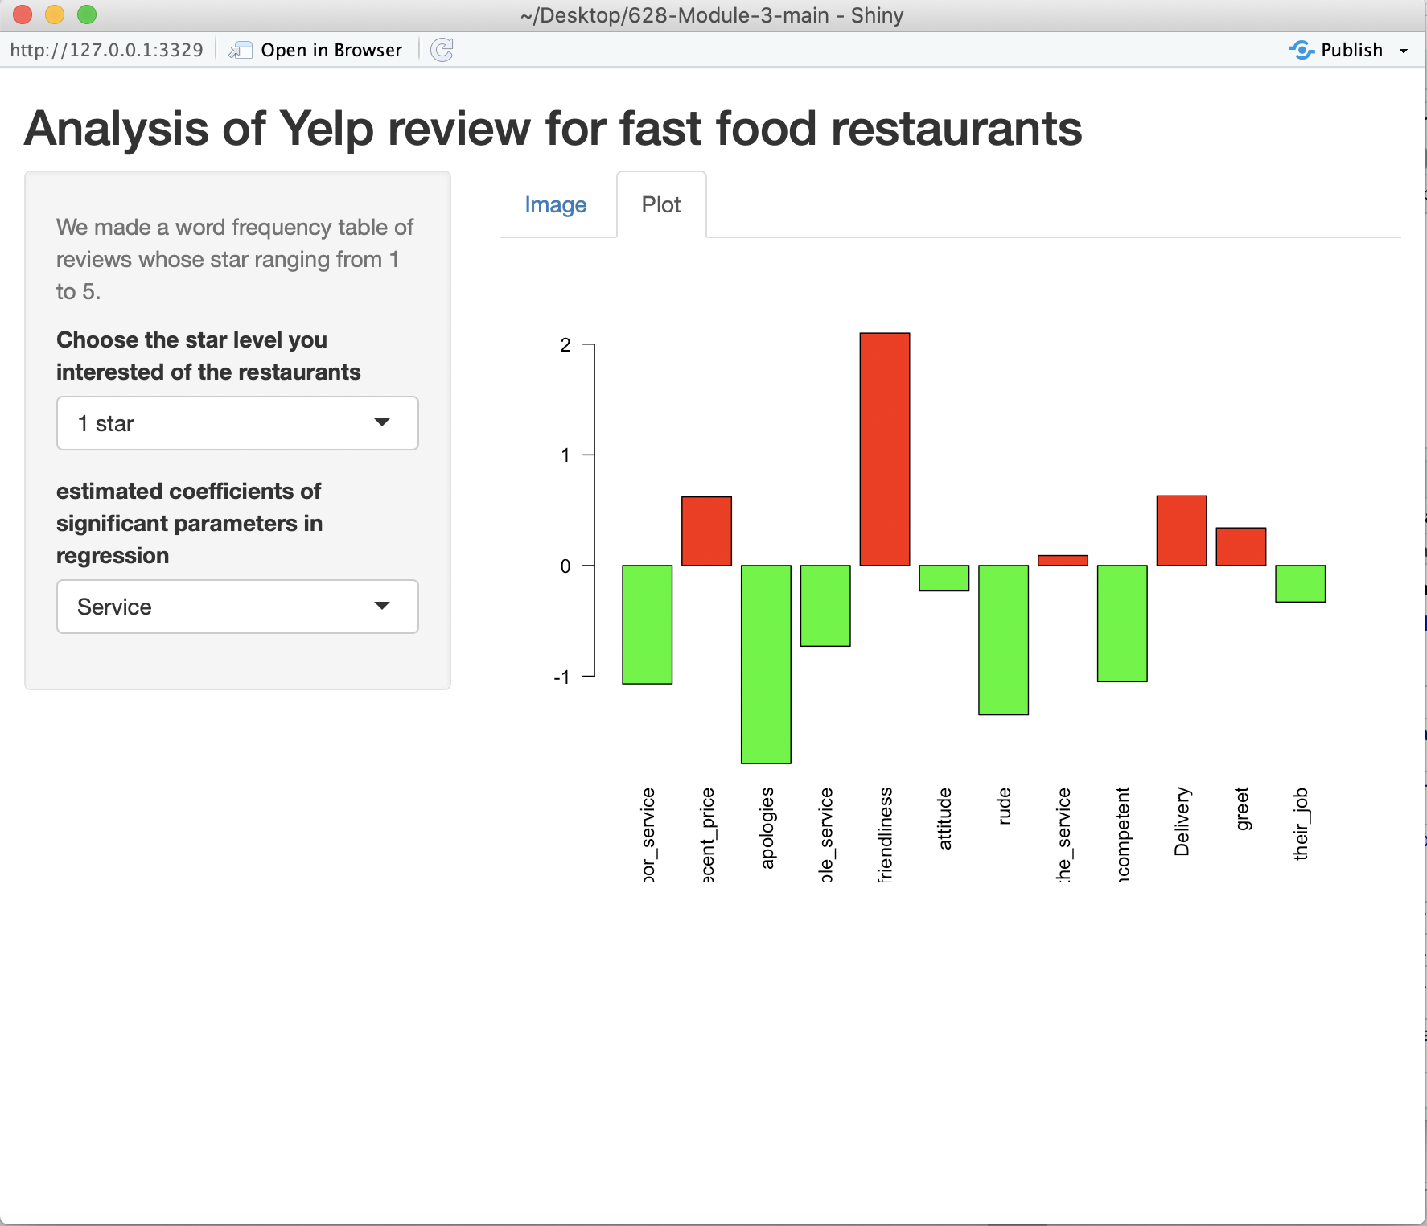

Shiny App Demonstration

